Slide 1
Advanced Computational Science
Articulation Points in Multiplex Networks
Student: Artem Vergazov
Research Advisor: Vladimir Palyulin
January 2023

Slide 2
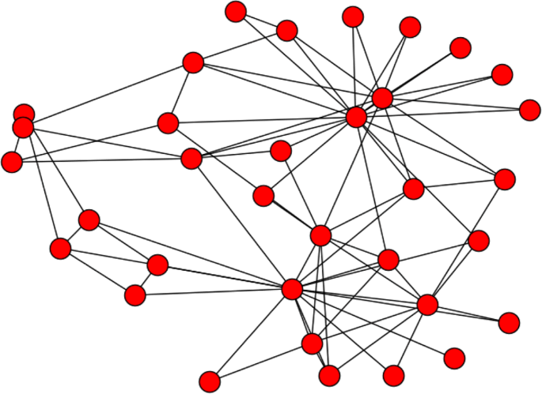
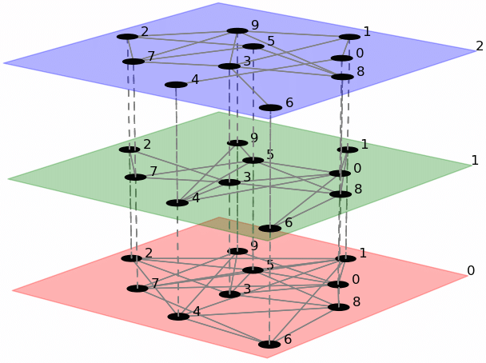
Introduction. Networks
Simple network
Multiplex network
Notes:
The area of my research covers articulation points behavior in multiplex networks. First let me introduce the basic notions.
Many of the physical systems are represented efficiently by a notion of graphs, or networks. A model of graph provides the framework for modeling entities (nodes) and their interactions (edges). However, some phenomena are more naturally described by multiplex networks. A multiplex network is a collection of monoplex networks, or layers, where all the nodes exist simultaneously in all the layers but the links within each layer can differ.

Slide 3
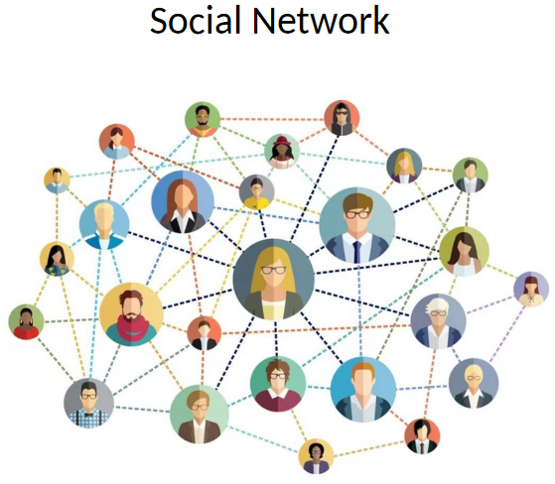
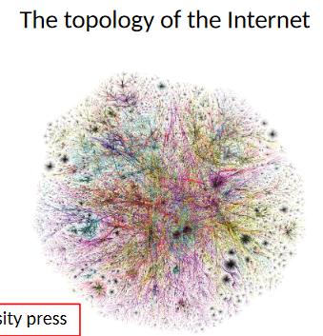
Introduction. Networks
Multiplex network examples
Transport
Underground layer
Bus layer
Social
Twitter layer
LinkedIn layer
Notes:
Examples of networks vary and can be found in different fields of science. For example, social networks, the Internet. An example of a multiplex network can be a transportation network, or a social network, too.

Slide 4
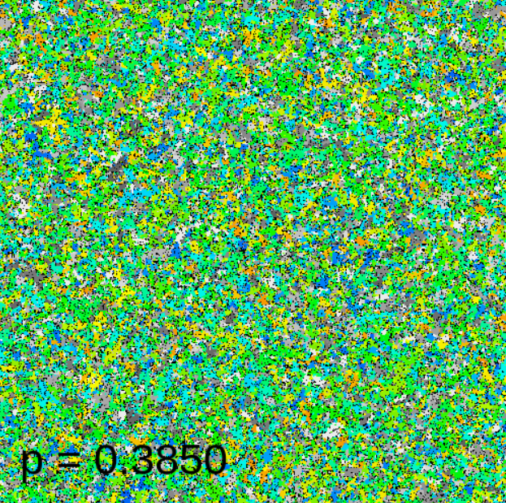
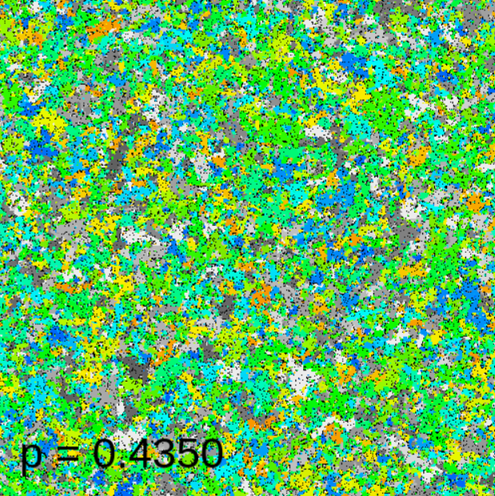
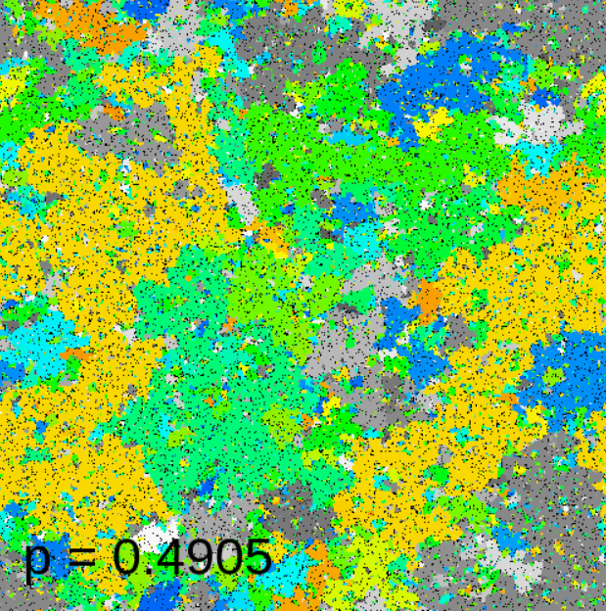
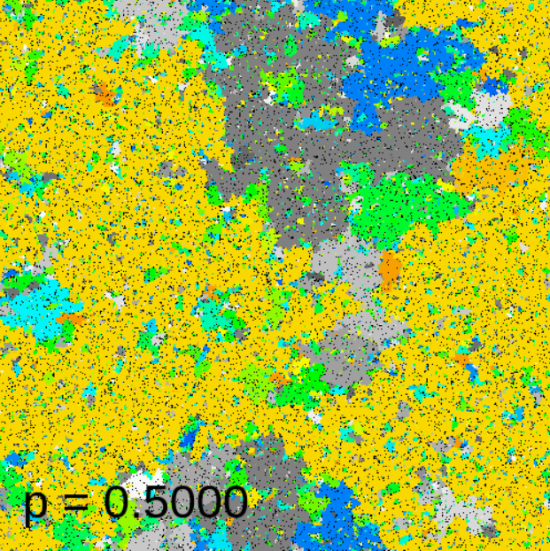
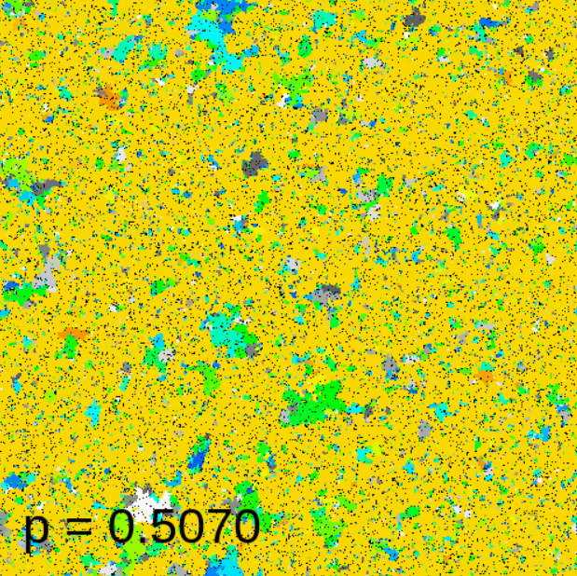
Introduction. Percolation
Notes:
One of the manifestations of the difference between a multiplex network and a monoplex network rises in the percolation theory. Consider a random graph whose two randomly chosen nodes are connected with probability p. If the parameter p increases, will there occur a giant connected component, a cluster of nodes that spans the entire network? It turns out that, in the limit of infinite network, there is a critical value of p: below that value, no giant cluster exists. This means that the system undergoes a phase transition at that critical value.

Slide 5
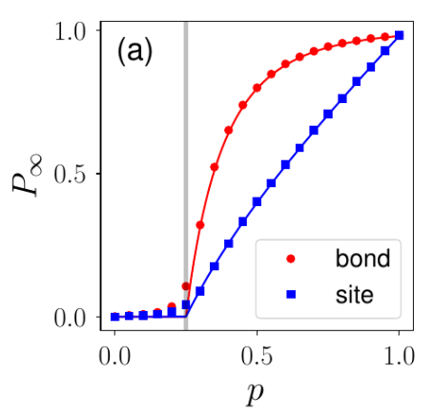
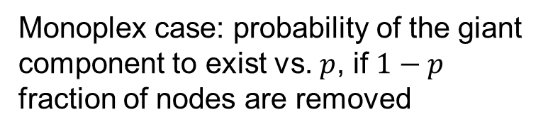
Introduction. Percolation
Monoplex case: probability of the giant component to exist vs. $p$, if $1−p$ fraction of nodes are removed
Notes:
For example, in this experiment, a fraction of nodes (1 - p) are removed from the network and the probability of existence of giant connected component is shown on the graph. There is a certain critical point at which the system undergoes a phase transition, and the existence of the giant component becomes possible.

Slide 6
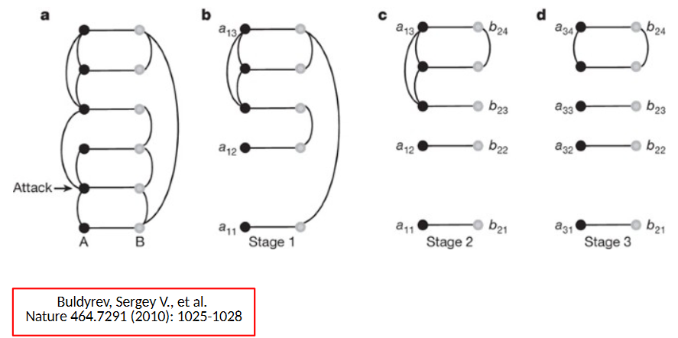
Introduction. Percolation
Notes:
However, to compare this result with the multiplex case, one must consider the effect of cascade of failures which only arises in the multiplex networks. When a certain node becomes disconnected from the network, it starts an avalanche-like process of failures of other nodes. For example, when one node fails, all its connections are removed from the network. Also, its replica from other layers of the network stop functioning, too. After the links are removed, each layer decays into sets of connected components. And the component can be considered functioning only if the nodes belonging to it coincide in all layers. Links between nodes of the layer b that correspond to different components in the layer a are removed, too, until no further splitting is possible.

Slide 7
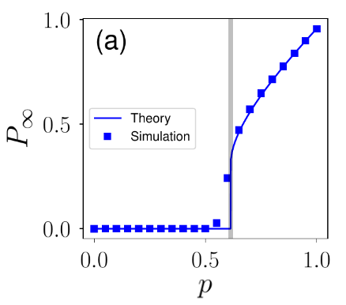
Introduction. Percolation
Monoplex case
Multiplex case
Notes:
This process leads to a percolation phase transition at a critical threshold, which is significantly larger than the equivalent threshold for a single network. This example illustrates the difference between monoplex and multiplex networks and suggests that multiplex networks are treated as more complicated physical objects than single networks.

Slide 8
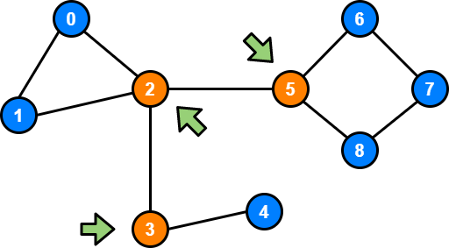
Introduction. Articulation points
An articulation point (AP) is a node whose removal disconnects the graph
Articulation points (AP)
Notes:
My research focuses on studying the articulation points (AP) behavior in multiplex networks. An articulation point is any node in a graph whose removal increases the number of connected components. Being able to find articulation points and understanding the patterns of their behavior can help prevent crucial systems from destruction or find weaknesses in such systems.

Slide 9
Aim
Study of articulation points in multiplex networks
Study the difference in behavior (network dismantling, network attacks, node failure) between simple and multiplex cases
Notes:
So, the overall purpose of the work is to generalize the AP concepts to the multiplex case and compare the effects that occur between simple and multiplex cases.

Slide 10
Objectives
Reproduce the results for simple networks
Study APs in Erdős–Rényi multiplex networks
Study APs in configuration networks
Check the statistics of real-world multiplex networks
Erdős–Rényi network, configuration network are common types of a random graph
Notes:
The objectives of my research are as follows:
1 Study the literature and reproduce the results for simple networks
2 Study APs distribution in Erdős–Rényi multiplex networks
3 Compare with the case of configuration networks
4 Do some analysis on real networks

Slide 11
Algorithms and methodology
Generation of a set of networks from a certain distribution
Application of cascade of failures
Obtaining AP metrics (fraction)
Simulations in Python using NetworkX library for graph manipulation
Notes:
The usual outline for a numerical experiment with multiplex networks is as follows:
1 First generate a family of networks which are used to model the layers of the multiplex network
2 Apply the cascade of failures effect
3 Calculate the needed quantities, for example, the proportion of nodes which are APs
I do all simulations in Python and use the NetworkX open-source library which provides framework for graph manipulation.

Slide 12
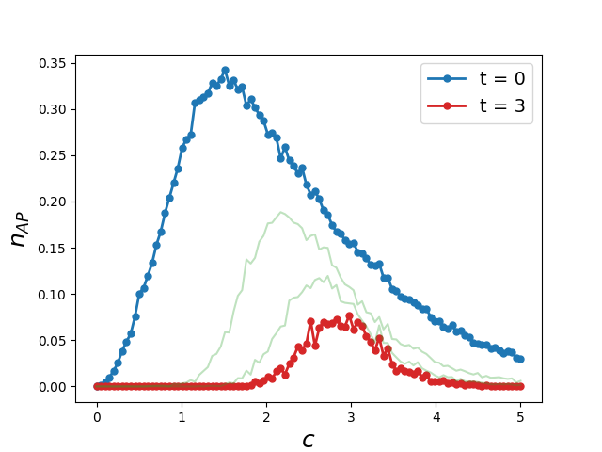
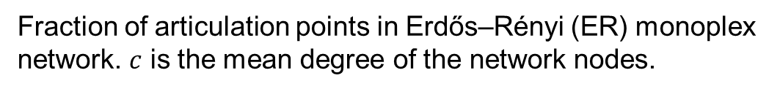
Results. Monoplex network
Fraction of articulation points in Erdős–Rényi (ER) monoplex network. $c$ is the mean degree of the network nodes.
Review: Tian, L. et al. Articulation points in complex networks.
Nat. Commun. 8, 14223 doi: 10.1038/ncomms14223 (2017).
Notes:
Here are reproduced results of the paper cited on the screen. The main idea of the experiment is as follows: at each step, all APs in the monoplex random graph are removed. At the next step, all APs of the resulting graph are removed, and so on. The graph displays the fraction of APs at each time step vs. the mean degree of the nodes. With each step, the curve shifts to the right which means that the number of links required to sustain a connected graph grows with the removal of nodes.

Slide 13
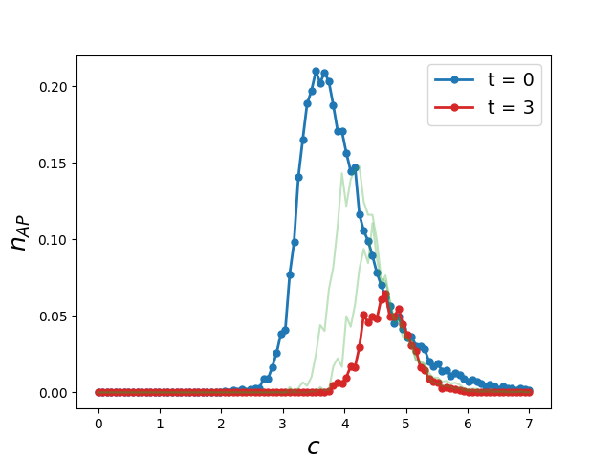
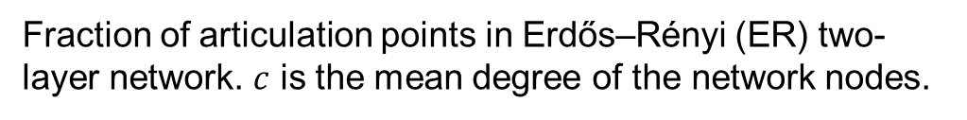
Results. Multiplex network
Fraction of articulation points in Erdős–Rényi (ER) two-layer network. $c$ is the mean degree of the network nodes.
Notes:
The same experiment can be conducted for the multiplex case, but the cascade of failures effect has to be taken into account. One can see qualitatively different curves. Now it takes larger values of c to sustain a connected graph because of this effect. These are the new results for the multiplex network case.

Slide 14
Results
Monoplex case
Multiplex case
Notes:
Here are the two graphs for comparison. These results suggest that a multiplex network takes more connections than a monoplex network to stay functioning because of the cascade of failures effect. When building new systems with multilayer structure, these effects should be taken into account in order to avoid a system destruction in case of accidental node failure. It can also be seen that no giant component is possible after the cascade of failures in the multiplex network if c is less than 2.5, and the confirmation of this fact will be shown on the next slide.

Slide 15
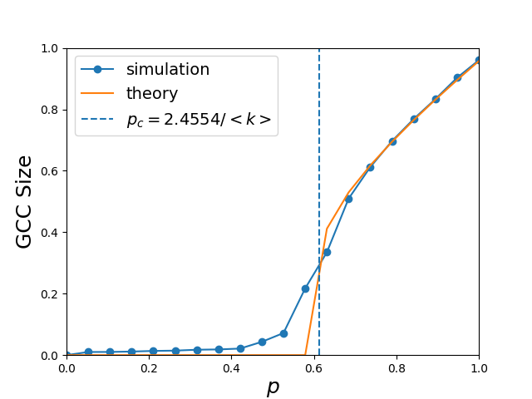
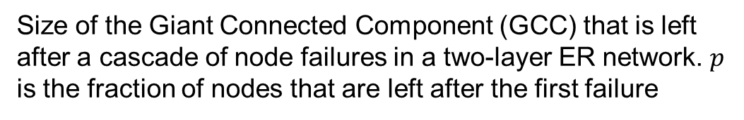
Results
Review: Buldyrev, S., Parshani, R., Paul, G. et al. Catastrophic cascade of failures in interdependent networks. Nature 464, 1025–1028 (2010). https://doi.org/10.1038/nature08932
Size of the Giant Connected Component (GCC) that is left after a cascade of node failures in a two-layer ER network. $p$ is the fraction of nodes that are left after the first failure
Notes:
This is reproduction of the results of the paper cited on the screen. The picture shows the size of the giant component in the multiplex network after the cascade of failures. And it clearly suggests that below the phase transition threshold 2.5 no giant component exists. The dashed line shows the exact theoretical threshold in the limit of infinite network.

Slide 16
Discussion and conclusions
For monoplex networks, results agree with previous studies and theoretical predictions
For multiplex networks, we see the change in the fraction of APs because of the cascading behavior
Notes:
[[Read the slide]] These results suggest that in both cases some sort of phase transition happens. However, in the multiplex case, the phase transition is harder to achieve, and it happens differently. This phenomenon requires further research.

Slide 17
Current status and outlook
Literature review has been the main focus so far.
A number of published results reproduced.
Initial results on multiplex networks.
Next steps:
Feb 2023: study APs in configuration networks
Mar 2023: real-world network analysis
Apr 2023: paper
May-June 2023: thesis
Notes:
Currently, the literature review is mostly done, results of the previous research have been reproduced and initial results on multiplex networks have been obtained. The future steps of the research are to do similar experiments with the configuration multiplex networks and then compare the results with the current results. Next stepa of the plan are to study some real network examples, present all results in a paper and, finally, work on thesis.

Slide 18
Acknowledgements
Prof. Vladimir Palyulin
Saeed Osat
Notes:
I am grateful to my advisor Professor Palyulin for his guidance and to Mr. Saeed Osat, who helps me with the experiments.

Slide 19
Thank you for attention
Notes:
Thank you for your attention. Now I’m ready to answer your questions.

